Slide 1
ATM Console-Based Interface
for Your Banking Needs
By swaraj Jogi

Slide 2
Introduction
Features and Functionality
Security Measures
Benefits
Challenges and Limitations
Conclusion

Slide 3

Introduction
ATM interface console based application is a software that allows users to interact with automated teller machines (ATMs) The software provides a user-friendly experience for customers to perform various banking transactions such as withdrawing cash, checking account balance, and transferring funds.
The ATM interface console based application has revolutionized the way people bank by providing them with a convenient and secure way to access their accounts anytime, anywhere.

Slide 4
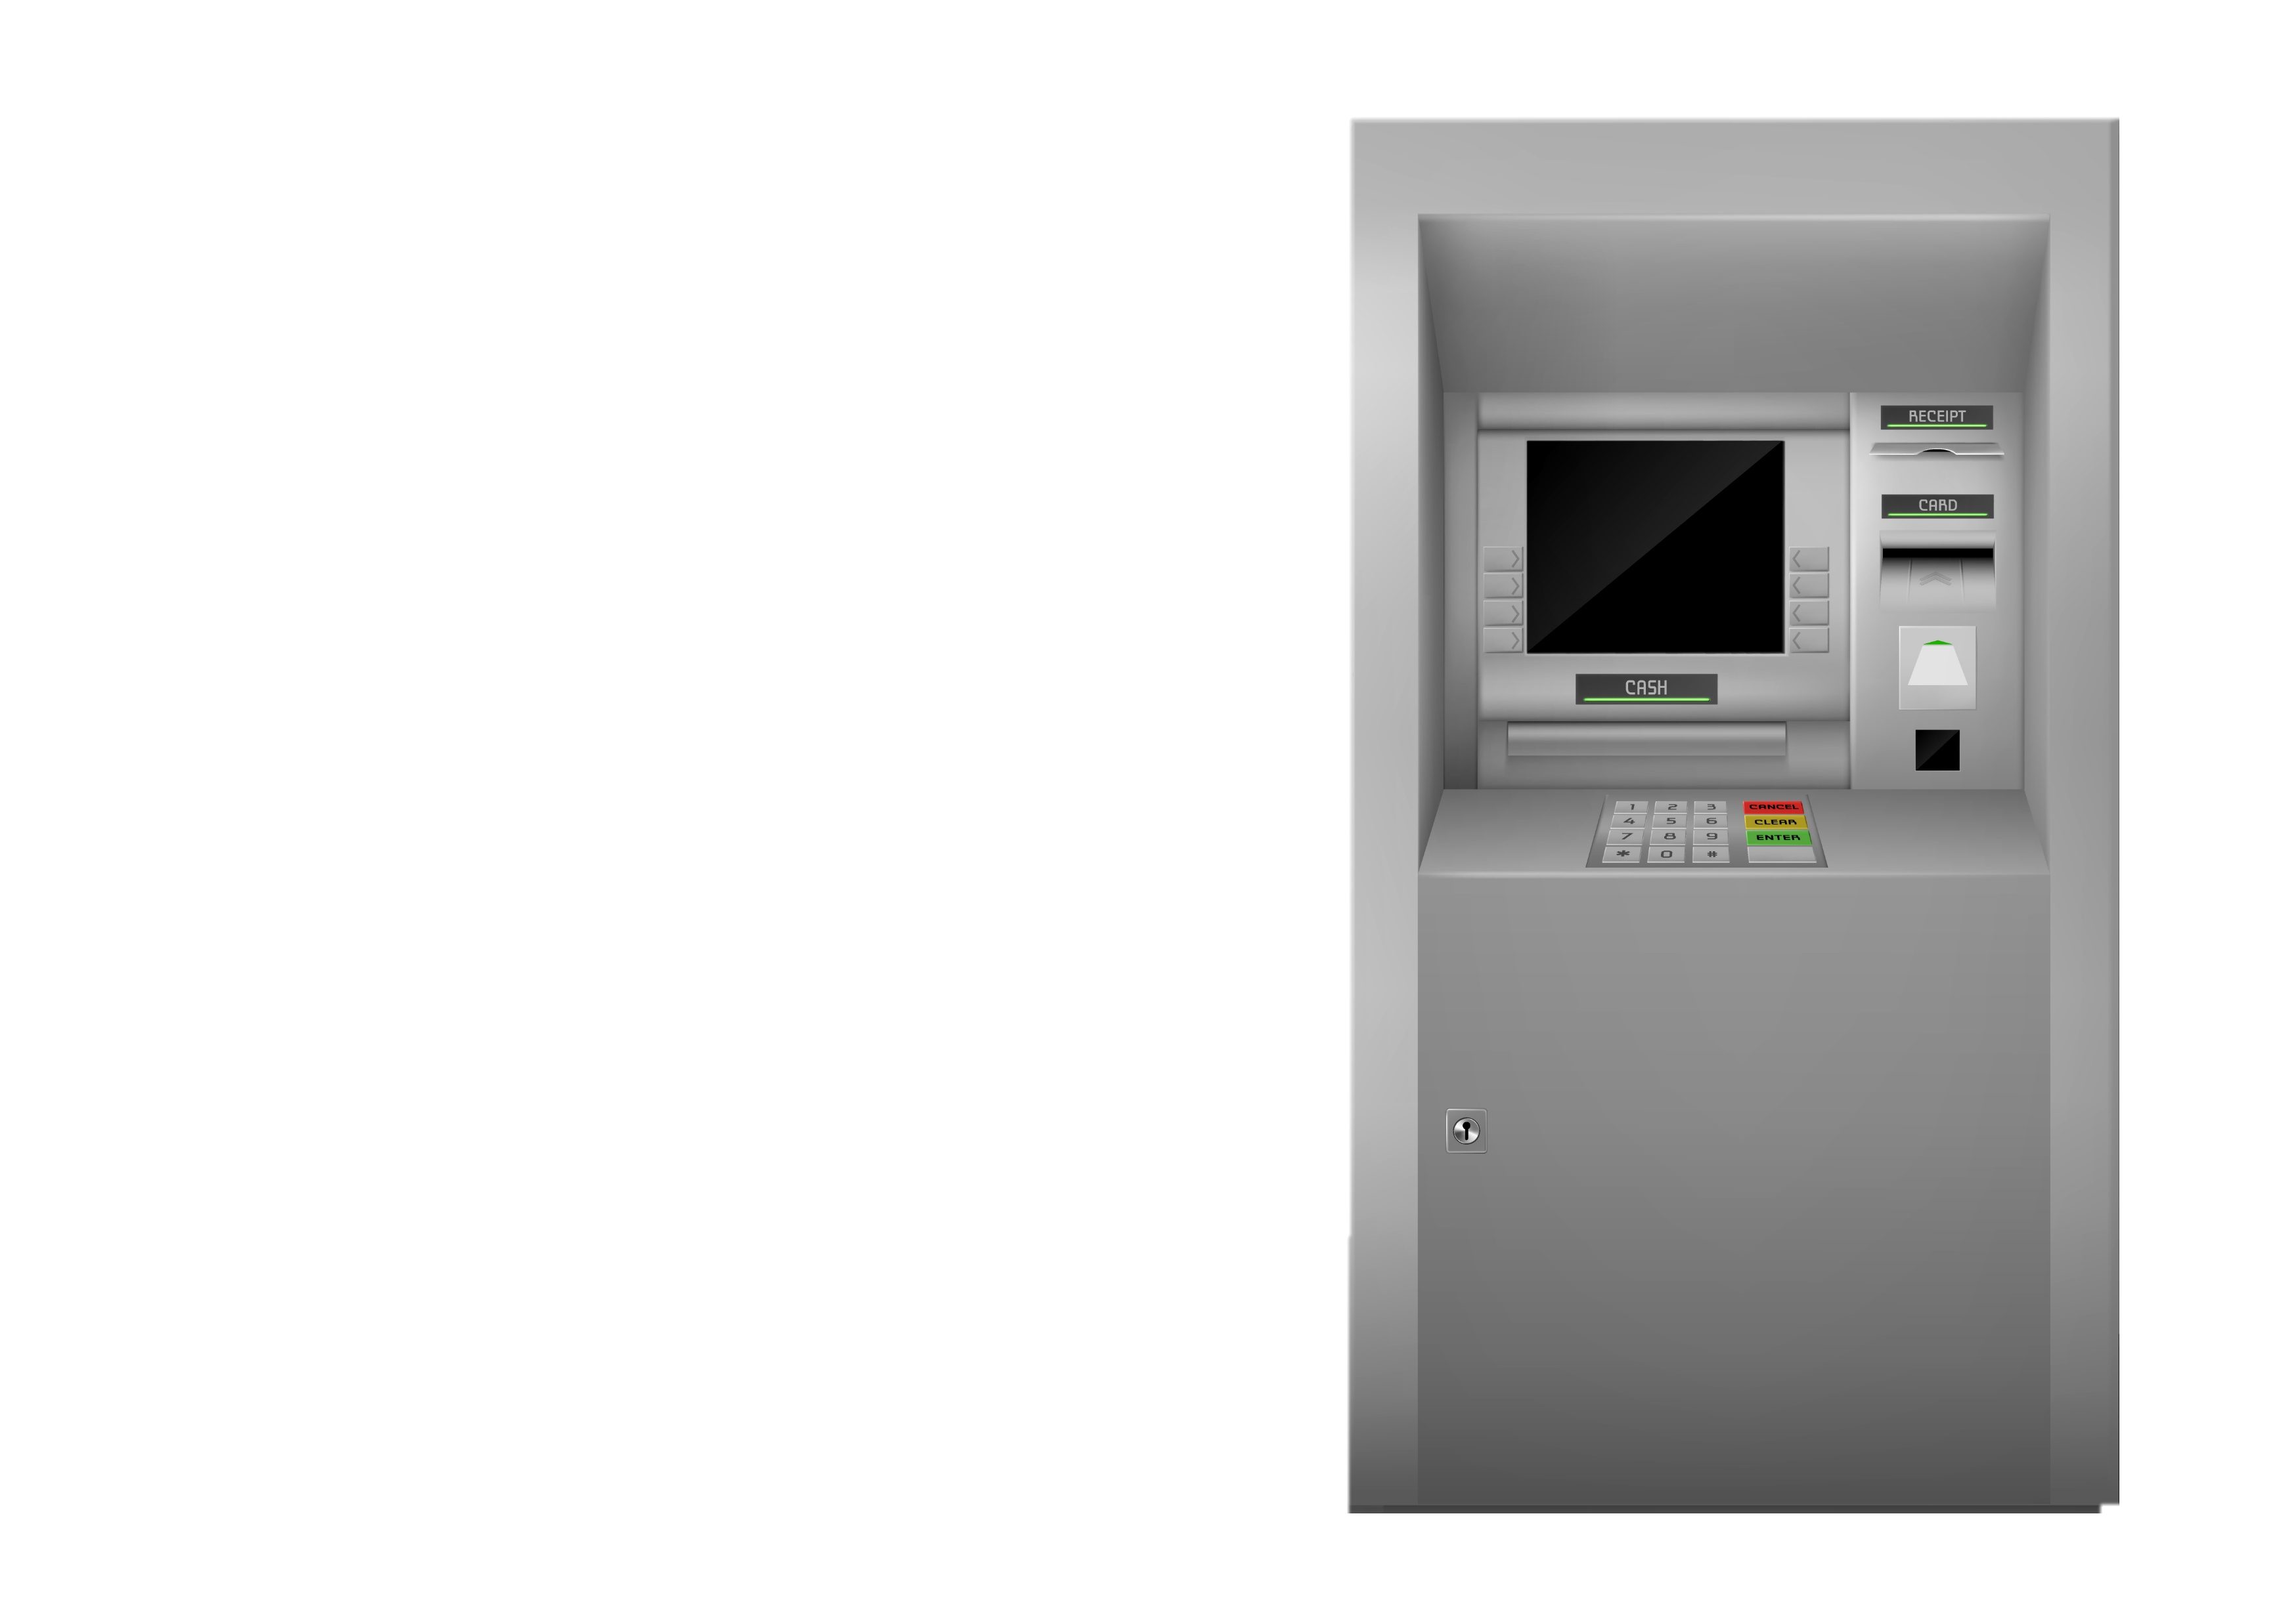
Features and Functionality
The ATM interface console based application comes with a range of features and functionalities that make it easy for customers to use. The software has a simple and intuitive interface that allows customers to navigate through the different options easily.
Customers can perform various transactions using the application such as cash withdrawals, balance inquiries, and fund transfers. The software also allows customers to view their transaction history and print receipts for their transactions.

Slide 5

Security Measures
Security is a top priority when it comes to banking, and the ATM interface console based application ensures that customers' information and transactions are secure. The software uses encryption technology to protect customers' personal and financial information from unauthorized access.
In addition, the software has built-in security features such as PIN authentication and card verification to prevent fraud and ensure that only authorized individuals can access the ATM machine and perform transactions.

Slide 6

Benefits
The ATM interface console based application offers several benefits to both customers and banks. For customers, the software provides a convenient and secure way to access their accounts and perform transactions without having to visit a physical bank branch.
For banks, the software reduces the need for physical branches and staff, resulting in cost savings. It also allows banks to provide round-the-clock services to customers, increasing customer satisfaction and loyalty.

Slide 7

Challenges and Limitations
While the ATM interface console based application offers many benefits, there are also some challenges and limitations associated with its use. One of the major challenges is ensuring that the software is compatible with different types of ATMs and operating systems.
Another limitation is the potential for technical glitches and downtime, which can cause inconvenience to customers and affect the reputation of the bank. Additionally, the software may not be accessible to customers who are not tech-savvy or have limited access to technology.

Slide 8

Conclusion
The ATM interface console based application has transformed the way people bank by providing them with a convenient and secure way to access their accounts and perform transactions. The software offers several benefits to both customers and banks, including cost savings and increased customer satisfaction.
However, there are also challenges and limitations associated with its use, such as compatibility issues and technical glitches.

Slide 9
Thank
You
PPT by swaraj jogi

